Slide 1
Last Week
This Week
Manuscript preparation
Input mode comparison
1x2 splitter (TE)
Manuscript preparation (figure)

Slide 2
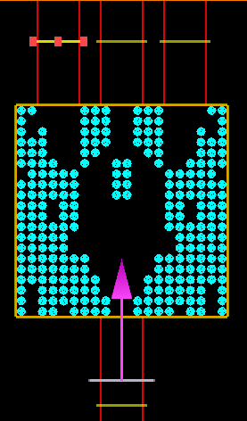
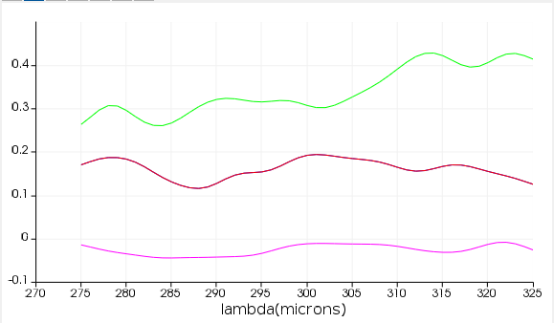
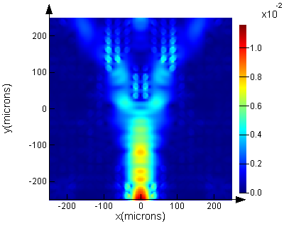
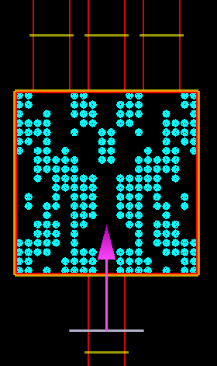
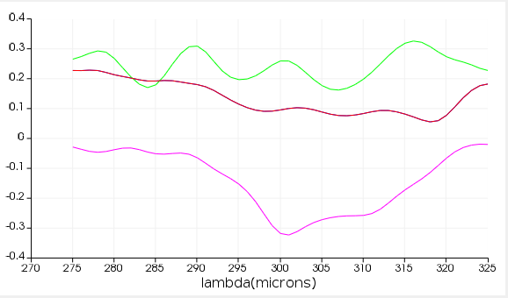
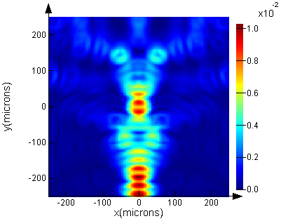
Splitter Input Mode Comparison
# of data: 20,000
FOM = T₁+T₂+T₃ - |R|
TE
T₁
T₂
T₃
T₂
T_{1,3}
R
Input
E
TM
T₂
T₁
T₂
T₃
T_{1,3}
R
Input
E

Slide 3
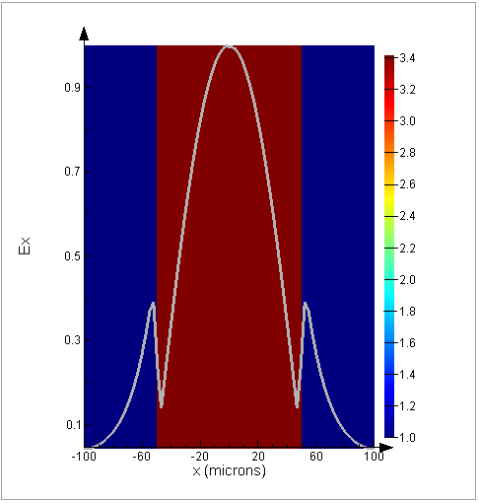
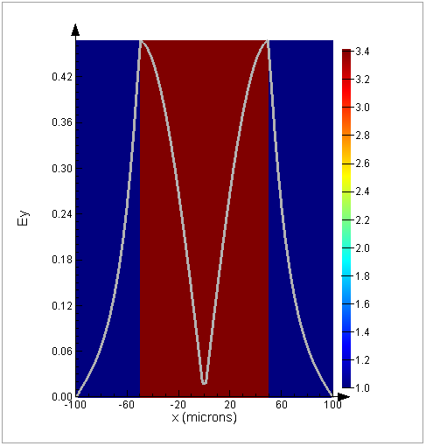
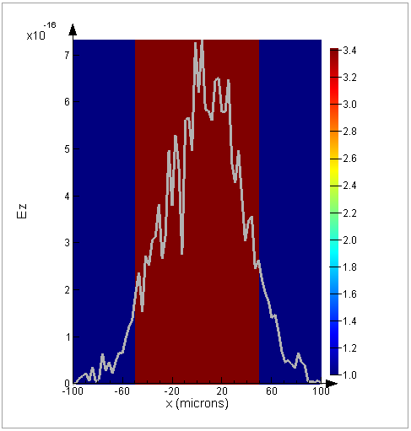
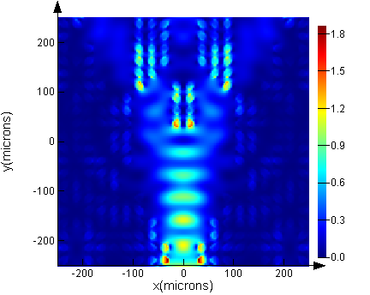
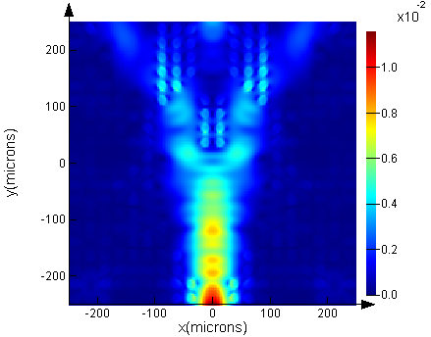
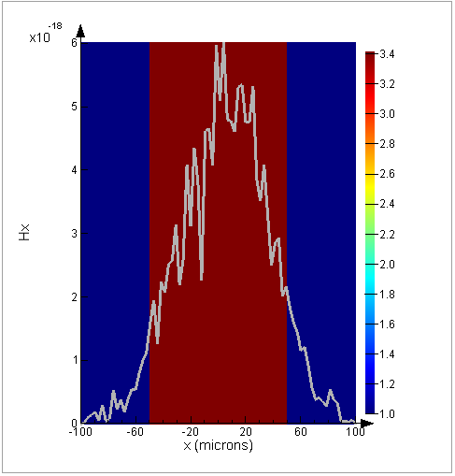
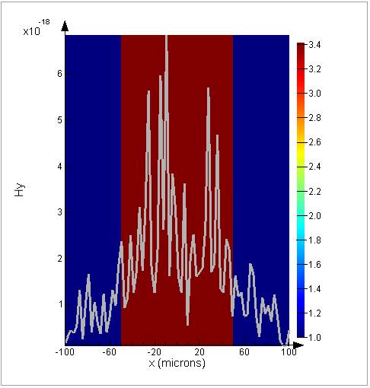
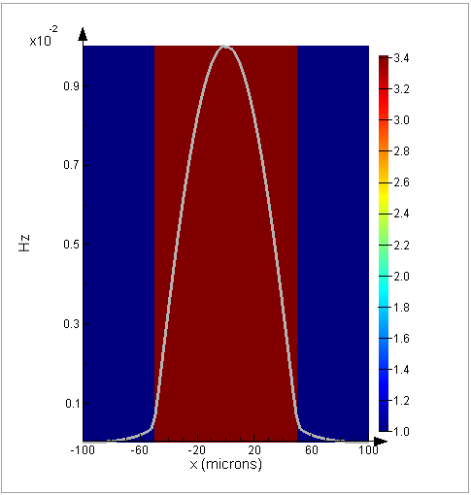
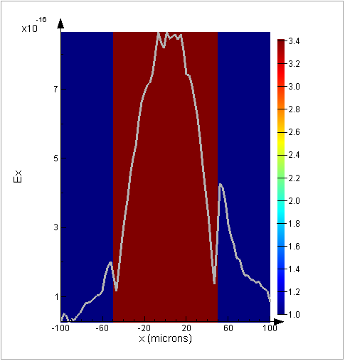
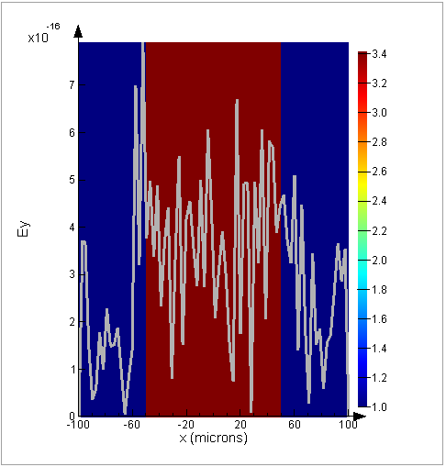
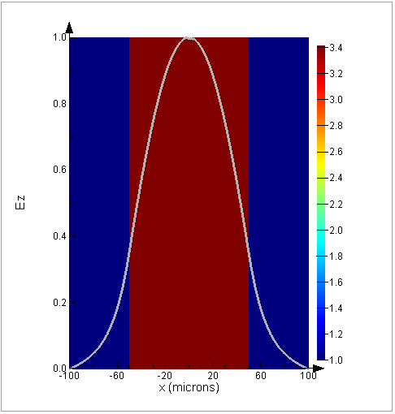
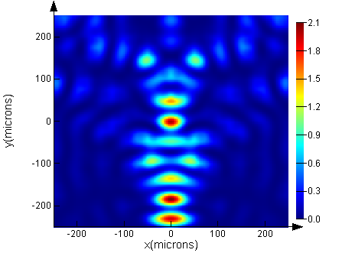
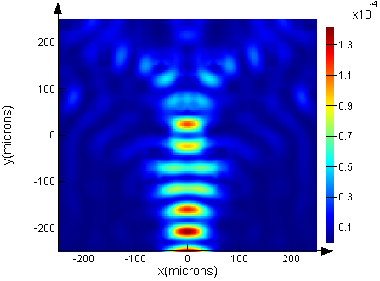
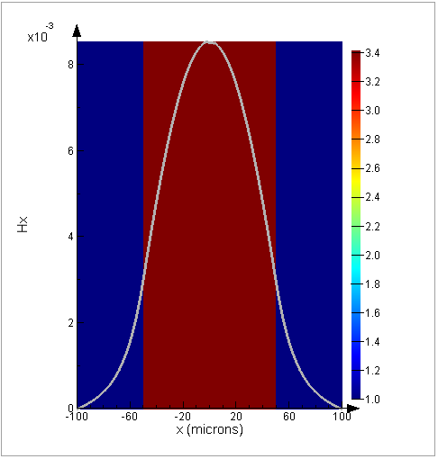
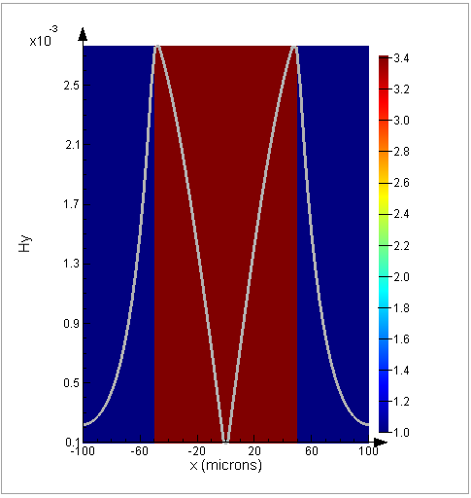
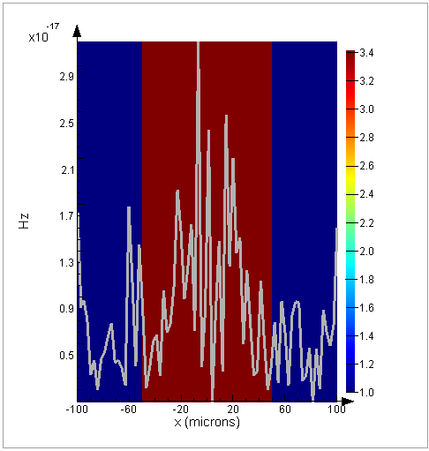
Splitter Input Mode Comparison
TE
E_{x}
E_{y}
E_{z}
|E|²
|H|²
H_{x}
H_{y}
H_{z}
y
x
z
TM
E_{x}
E_{y}
E_{z}
|E|²
|H|²
H_{x}
H_{y}
H_{z}

Slide 4
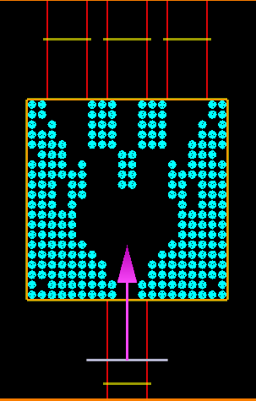
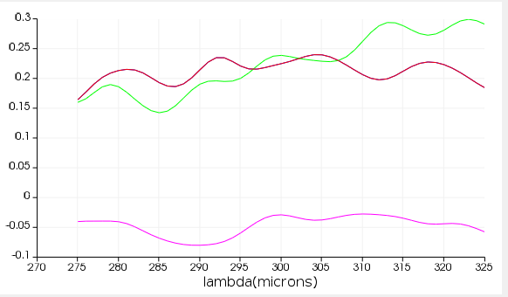
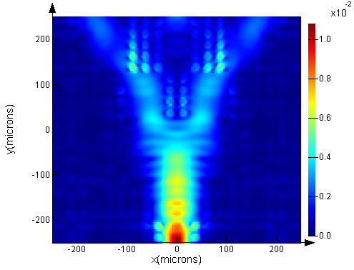
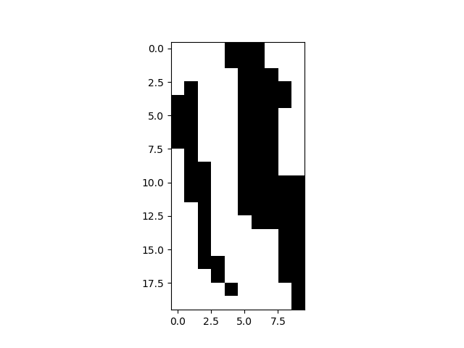

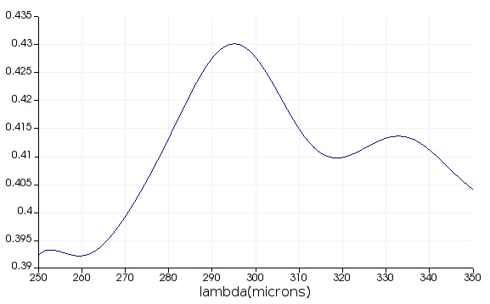
Splitter Input Mode Comparison
# of data: 57,000
FOM = T₁+T₂+T₃ - |R| - r*|T₁-T₂|, r=0.2
1x3 splitter TE
T₃
T₂
T₁
T₂
T_{1,3}
R
Input
E
Power uniformity = 2.17 ±0.75 dB
1x2 splitter TM - 190708
# of data: 40,000
FOM = T₁+T₂ - |R|
T₁
T₂
T₁ ~0.41
T₂ ~0.41
E
Power uniformity = 0.42 dB

